Slide 1
Oracle PL/SQL
Code Review Agent
Standards
DOCX
LLM
Review
LLM-powered code review driven by an external
PL/SQL standards document
PL/SQL
Source
Proof of concept

Slide 2
1. Problem & Opportunity
Why explore AI-assisted PL/SQL review?
Standards are external
Review effort is manual
Context matters
Coding standards can evolve over time.
Hardcoding every review rule creates
maintenance overhead.
Developers and reviewers spend time
checking repetitive standards and explaining
findings.
Some review findings need code context,
an explanation, and a practical
recommendation—not just a pattern match.
Opportunity
• Use an LLM to interpret the supplied standards in the context of PL/SQL code.
• Keep the review policy outside the application code.
• Return structured, actionable findings for developers.
Oracle PL/SQL Code Review Agent | G2E / US Office PoC
2

Slide 3
2. Proposed Solution
A standards-driven PL/SQL review workflow
1
Upload Standards
2
Provide PL/SQL
3
Extract Standards
4
LLM Review
5
Structured Findings
Core design principle
The coding policy is externalized. The current standards document is read at review time and supplied to the LLM as context.
Result: standards can change without changing the Python review logic.
Oracle PL/SQL Code Review Agent | G2E / US Office PoC
3

Slide 4
3. PoC Architecture
What each component is responsible for
standards_reader.py
Read DOCX
Standards
DOCX
llm_reviewer.py
Build review context
Groq LLM
Structured JSON
Streamlit
Dashboard
rule_extractor.py
Create StandardRule[]
PL/SQL
Source
Structured output fields include Rule ID, severity, line, code, issue, standard and recommendation.
Oracle PL/SQL Code Review Agent | G2E / US Office PoC
4

Slide 5
4. Live Demo
The strongest proof point: change the standard, not the application
Scenario A — Standard V1
Result
Scenario B — Standard V2
DOCX says:
Local Variable → l_
Code uses:
l_employee_name
No violation
Same Python
Same PL/SQL
The code complies with the supplied standard.
DOCX changes:
Local Variable → lv_
Same code remains:
l_employee_name
Observed result after changing only the DOCX
Violation detected
The LLM reports that l_employee_name does not meet the new lv_ standard and provides a recommendation.
Key message: policy change → review behavior change → no Python code change.
Oracle PL/SQL Code Review Agent | G2E / US Office PoC
5

Slide 6
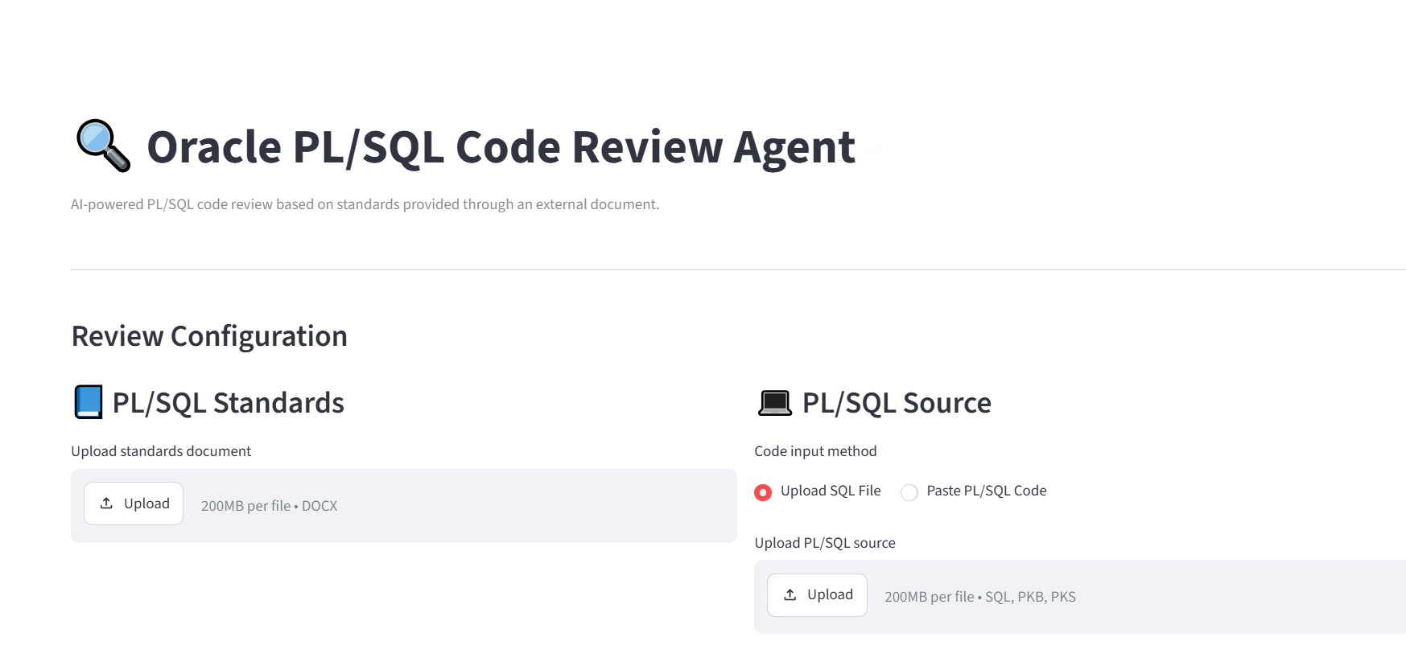
4.1 POC Screenshots
Oracle PL/SQL Code Review Agent | G2E / US Office PoC
5

Slide 7
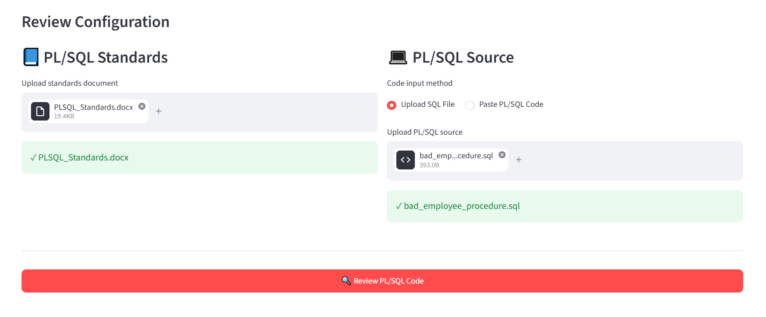
4.2 POC Screenshots
Oracle PL/SQL Code Review Agent | G2E / US Office PoC
5

Slide 8
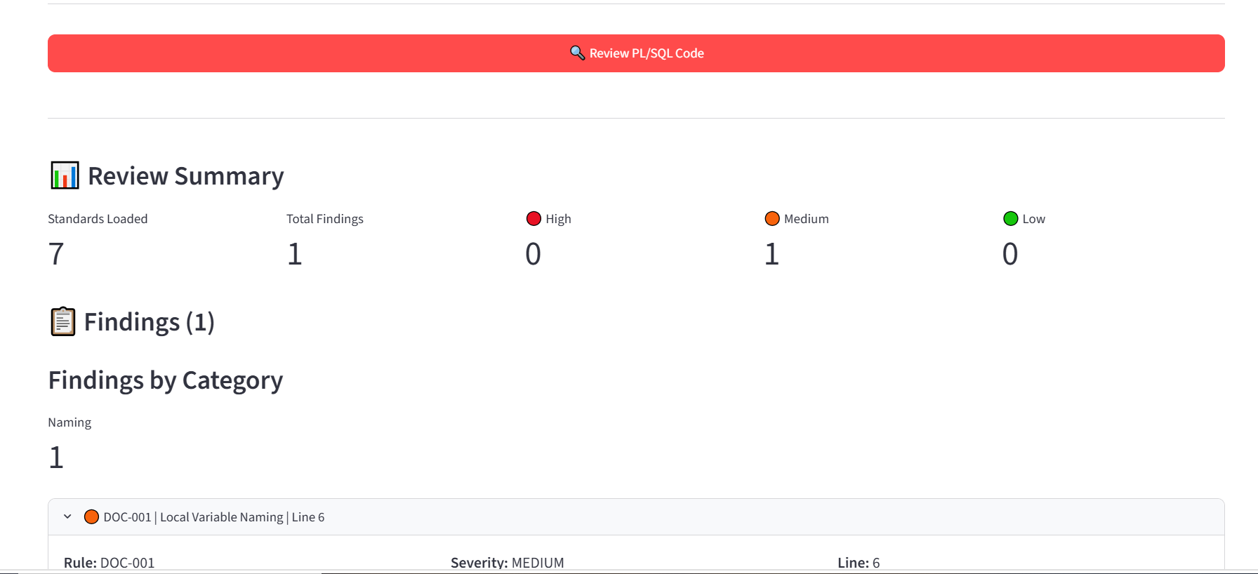
4.3 POC Screenshots
Oracle PL/SQL Code Review Agent | G2E / US Office PoC
5

Slide 9
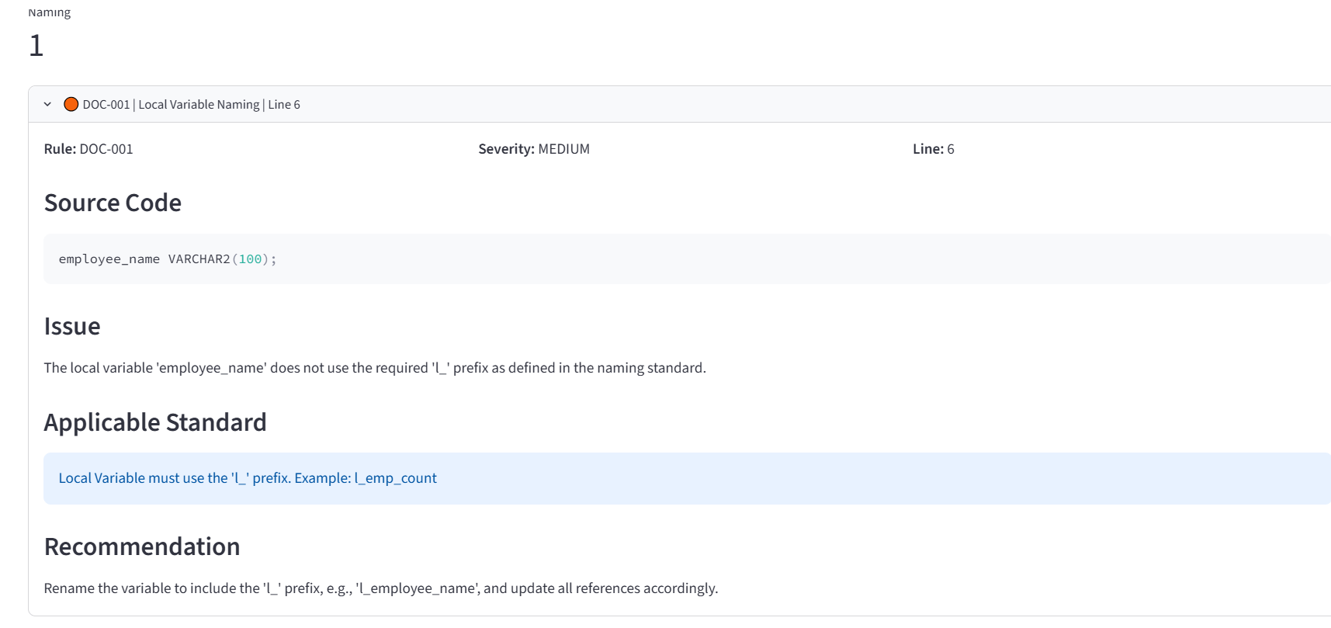
4.4 POC Screenshots
Oracle PL/SQL Code Review Agent | G2E / US Office PoC
5

Slide 10
5. Review Output
Actionable findings rather than a generic pass/fail
Standards Loaded
7
Total Findings
3
High
0
Medium
3
Low
0
DOC-003 | MEDIUM | Line 2
Parameter 'employee_id' does not use the required p_ prefix.
Recommendation: rename to p_employee_id.
DOC-001 | MEDIUM | Line 6
Local variable 'employee_name' does not use the required prefix.
Recommendation is tied to the standard supplied in the document.
DOC-001 | MEDIUM | Line 7
Local variable 'bad_count' is reported with its source line and recommendation.
Oracle PL/SQL Code Review Agent | G2E / US Office PoC
6

Slide 11
6. Why an LLM?
Where LLM-based review adds value
Rule-based checks
LLM-based review
Future hybrid option
Strong for deterministic patterns:
• Naming conventions
• Simple syntax/pattern validation
• Fast and predictable
Useful when the rule needs context:
• Interpret the supplied standard
• Explain why code violates it
• Generate practical recommendations
Production can combine both:
• Deterministic checks for certainty
• LLM for contextual review and explanation
PoC choice
This PoC intentionally keeps the review logic LLM-driven to demonstrate document-only policy changes.
Oracle PL/SQL Code Review Agent | G2E / US Office PoC
7

Slide 12
7. Guardrails & Limitations
What the PoC does—and what it does not claim
Grounding
Structured output
Human review
The prompt instructs the LLM to use only
supplied standards and to reference
a Rule ID for every finding.
A strict JSON schema gives the application
a predictable result contract for the dashboard.
The PoC is an assistant, not an autonomous
approval gate. Findings should be validated
before production use.
Known PoC limitations
• LLMs can still make incorrect judgments; evaluation and test suites are required.
• The current document parser is tailored to the prototype standards format.
• Confidential source code requires an approved/private model and security architecture before production.
Oracle PL/SQL Code Review Agent | G2E / US Office PoC
8

Slide 13
8. Future Production Architecture
A path from PoC to an internal developer capability
Standards
Repository
Deterministic
Checks
Review Engine
Findings +
Audit
Developer / SVN
PL/SQL
Parser
Private / Approved
LLM
Potential next steps
• Use approved internal/private model and enterprise security controls.
• Build a representative PL/SQL evaluation dataset and measure precision/recall-style quality metrics.
• Integrate with SVN for developer feedback before merge.
Oracle PL/SQL Code Review Agent | G2E / US Office PoC
9

Slide 14
9. Business & Developer Value
What this could enable if the PoC is productized
Consistency
Developer productivity
Maintainability
Apply documented standards consistently across PL/SQL development and reviews.
Reduce repetitive review effort and provide immediate explanations and recommendations.
Change standards centrally without embedding every policy change into application code.
Potential long-term extension
• Extend beyond naming conventions into contextual SQL, exception-handling, performance and security standards.
• Use repository history and review feedback to improve evaluation and developer guidance.
• Provide review results through IDE, pull-request or CI/CD integrations.
Oracle PL/SQL Code Review Agent | G2E / US Office PoC
10

Slide 15
10. Key Takeaway
The PoC demonstrates a practical path to
AI-assisted PL/SQL development.
Externalized standards • LLM reasoning • Structured findings • Human-in-the-loop
Next: validate against representative code, strengthen security, and evaluate integration with the development workflow.
Thank you
Oracle PL/SQL Code Review Agent | G2E / US Office PoC
11

